Slide 1

Markets in Crypto-Assets Regulation (MiCA)
EU regulation for crypto-assets and related services.
Establishes rules for issuance and management of cryptocurrencies.

Slide 2

Key Components of MiCA
1
Clear Rules
Standardized framework for crypto-asset market in EU.
2
Safety Measures
Ensures stability and minimizes risks for investors.
3
Service Regulation
Oversees issuance and related crypto-asset services.

Slide 3




Affected Parties
Issuers
Creators of crypto-assets, subject to licensing requirements.
Service Providers (CASPS’s)
Platforms and custody services, need operational licenses.
Consumers
Benefit from increased transparency and protection measures.

Slide 4
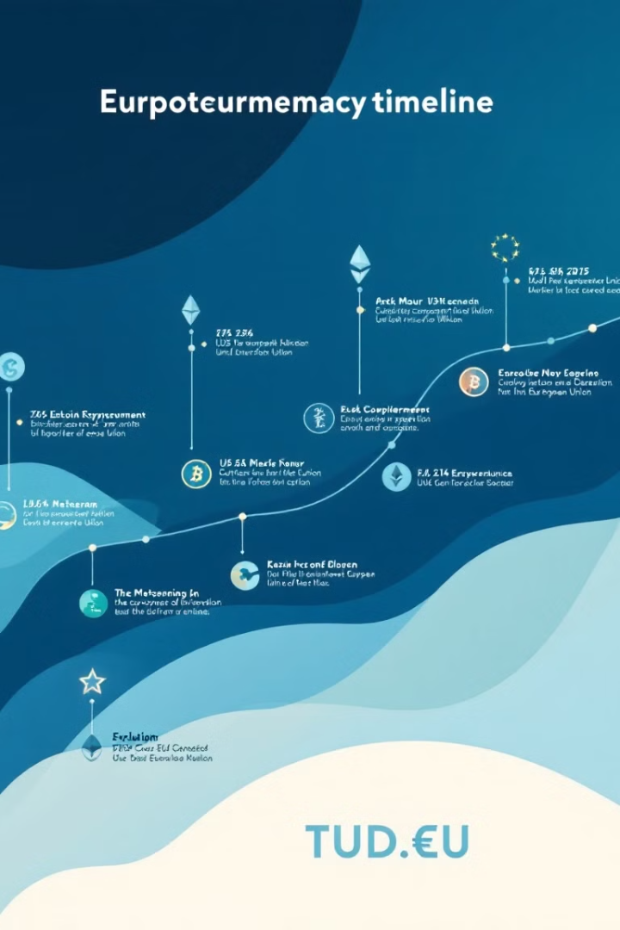
Implementation Timeline
1
Initial Phase
Introduction of regulatory framework to market participants.
2
Adaptation Period
Companies align operations with MiCA requirements.
3
Full Implementation
Complete integration of MiCA across EU crypto market.

Slide 5
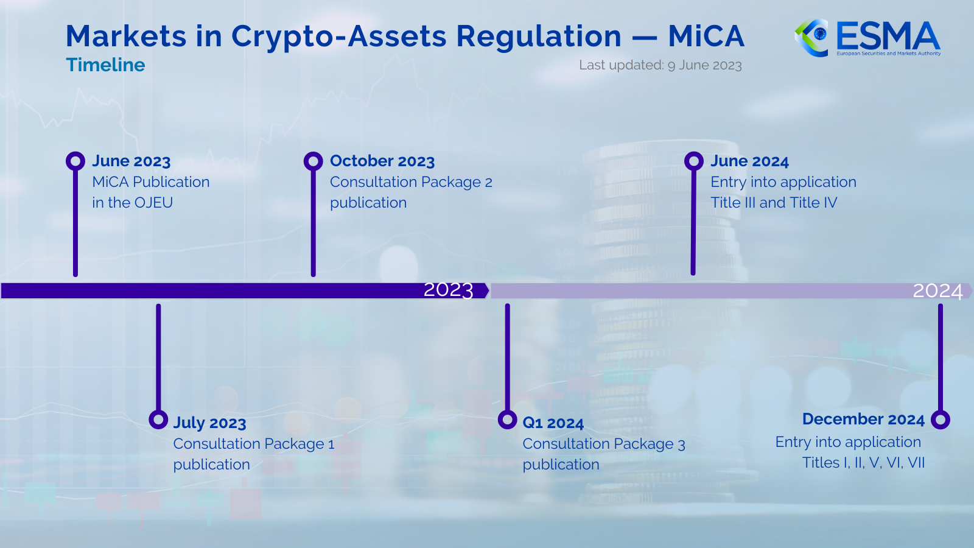

Slide 6




The Aims and Goals of MiCA
Protecting Consumers and Investors
Many people have lost money due to scams or unclear risks in crypto. MiCA wants to ensure everyone gets the information they need before making investments.
Stabilizing the Market
MiCA establishes consistent rules across the EU, which reduces the chance of problems like fraud or sudden company failures.
Encouraging Innovation
MiCA gives businesses a clear framework, allowing them to create new technologies without worrying about confusing laws.

Slide 7

Regulation
CASP Requirements
Authorisation by national regulators.
Governance standards for operations.
Maintaining minimum capital.
Secure custody of crypto-assets.

Slide 8
Regulation
CASP Requirements
Authorisation by national regulators.
Governance standards for operations.
Maintaining minimum capital.
Secure custody of crypto-assets.
Issuer Requirements
White paper.
Managing complaints effectively.
Disclosing environmental impact.

Slide 9
Regulation
CASP Requirements
Authorisation by national regulators.
Governance standards for operations.
Maintaining minimum capital.
Secure custody of crypto-assets.
Issuer Requirements
White paper.
Managing complaints effectively.
Disclosing environmental impact.
Other Requirements
Transparency.
Consumer protection measures.

Slide 10
Technologies behind it
Technologies affected by the regulation
MiCA primarily governs crypto-assets that are issued, transferred, and managed on blockchain and similar technologies. Some examples are:
Cryptocurrencies, with emphasis on stablecoins
Smart contracts
Technologies used by the regulators
Technologies used to track transactions in the blockchain:
Dedicated companies and tools:
TRM Labs, CipherBlade, etc.
Easily accessible resources:
BTCScan, Cryptomus, mempool, etc.

Slide 11
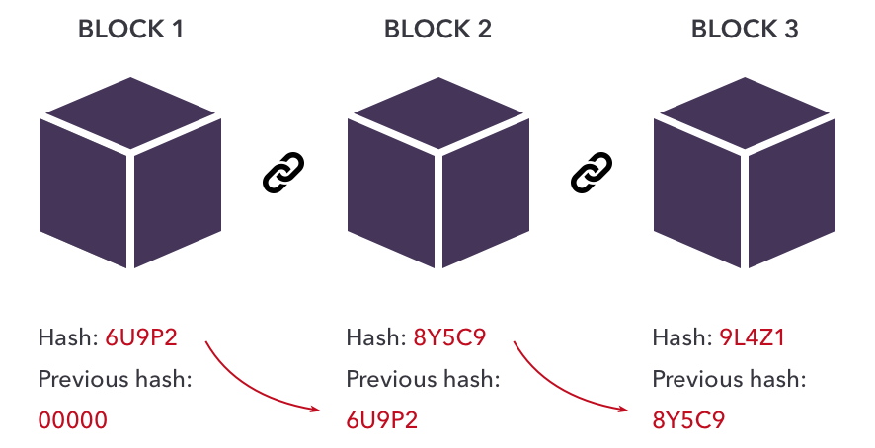
Technologies behind it
Blockchain
Decentralized, digital ledger that records transactions.
Transactions grouped into blocks, linked to the previous one forming a chain.
Data in a block cannot be altered without changing all subsequent blocks.
Cryptographic algorithms and consensus mechanisms to validate transactions.

Slide 12

Which institutions take care of MiCA?
European Commission and Parliament
Originally proposed by the European Commission, endorsed by the Parliament. The committee assigned responsible is the ECON, Economic and Monetary Affairs.
NCAs: National Competent Authorities (designated by each EU Member State)
Carry out function and duties provided by the regulation and inform EBA and ESMA. Can require CASPs (Crypto-Asset Service Providers) to provide information, and have power to suspend or prohibit crypto asset services.
EBA: European Banking Authority and ESMA: European Securities and Markets Authority
EBA, ESMA and the European System of Central Banks, must develop draft regulatory standards to determine the most relevant trading platforms and custodians.
CASPs: Crypto-Asset Service Providers
Must follow the MiCA rules, and must comply with the technical, security and privacy disclosure requirements.

Slide 13



Which institutions take care of MiCA?
EBA
NCAs
Informs
Write
Collaborates
ESCB
ESMA
Draft regulatory standards: determine most relevant trading platforms, etc.
Monitors
NCA: National Competent Authority
EBA: European Banking Authority
ESMA: European Securities and Markets Authority
ESCB: European System of Central Banks
CASP: Crypto-Asset Service Provider
CASPs
e.g. Crypto exchanges

Slide 14




Sectors Impacted by MiCA
Finance and Banking
Technology and Blockchain
Fintech companies and banks that offer crypto services must ensure MiCA to ensure safe and transparent operations.
Companies that develop blockchain platforms and tools for managing crypto-assets must align with MiCA's safety and security standards.
Retail
Investment
Online stores that accept crypto payments must comply with MiCA to keep transactions safe.
Investment funds or platforms that offer crypto-assets must comply with MiCA. This ensures investors are informed about risks, helping them make safer choices.

Slide 15
Bibliography
What is Markets in Crypto-Assets (MiCA)? https://www.investopedia.com/what-is-market-in-crypto-assets-6751039
ESMA: Markets in Crypto-Assets Regulation (MiCA) https://www.esma.europa.eu/esmas-activities/digital-finance-and-innovation/markets-crypto-assets-regulation-mica
Regulation on Markets in Crypto-Assets (MiCA) https://finance.ec.europa.eu/system/files/2023-02/210724-proposal-regulation-markets-crypto-assets-mica_en.pdf
The EU's new MiCA regulation for crypto and why it matters https://www.euronews.com/next/2023/05/18/explained-the-eus-new-mica-regulation-for-crypto-and-why-it-matters
EU agrees pioneering rules for fair crypto-assets market https://www.europarl.europa.eu/news/en/press-room/20230417IPR80137/eu-agrees-pioneering-rules-for-fair-crypto-assets-market

